Slide 1
Dual Reaction Wheel Updates
Yuen Bak Ching, Clay Dodson, Ethan Kee, and Alexander Sun

Slide 2
Problem Statement
Create a Reaction Wheel Pendulum which uses flywheels to stabilize itself
Will start and remain upright (θ < 10º)
Can accept light disturbances (F < 10N)
Adjusts to weights being added (up to 5g)

Slide 3
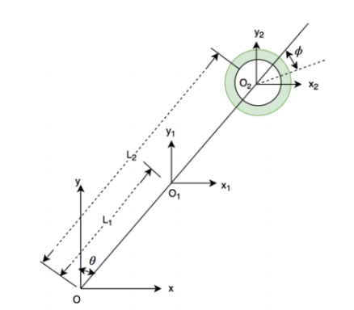

System Model and EoM
Can use Lagrange’s equations:
Generalized coordinate q_{i} is pendulum and reaction wheel angles, θ and ϕ
𝜏_{i} is the total torque acting at each point

Slide 4










State Space Model

Slide 5



The Control Law
q₁ = 1/500 (pendulum angular velocity )
q₂ = 1/100 (flywheel angle )
q₃ = 1/5000 (flywheel angular velocity )
R = 1/100
Final LQR Gains: [0.8597, 0.1342, 0.0432]

Slide 6
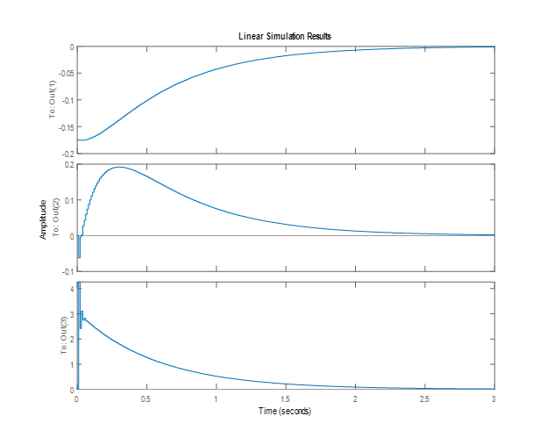
Simulation

Slide 7
Hardware Selection
Sensor selection criteria: Able to have both accelerometer and gyroscope
MPU-6050 Accelerometer and Gyroscope
Actuator selection criteria: High torque, with encoder
2x UXcell DC 12V 350 RPM Encoder Gear Motors
MCU: MSP432P401R

Slide 8
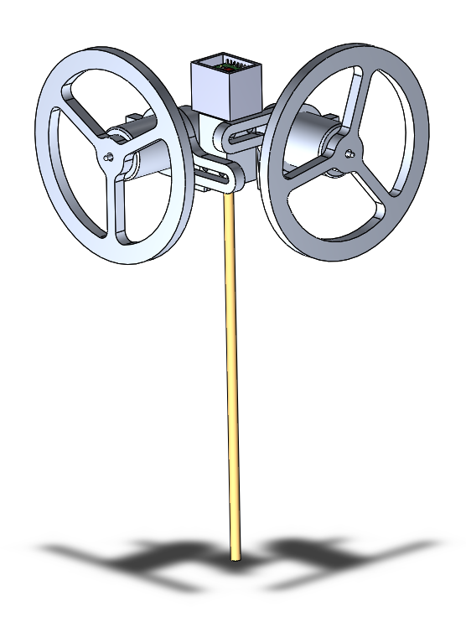
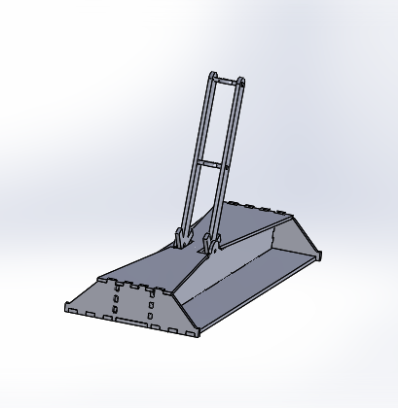
Initial Design

Slide 9
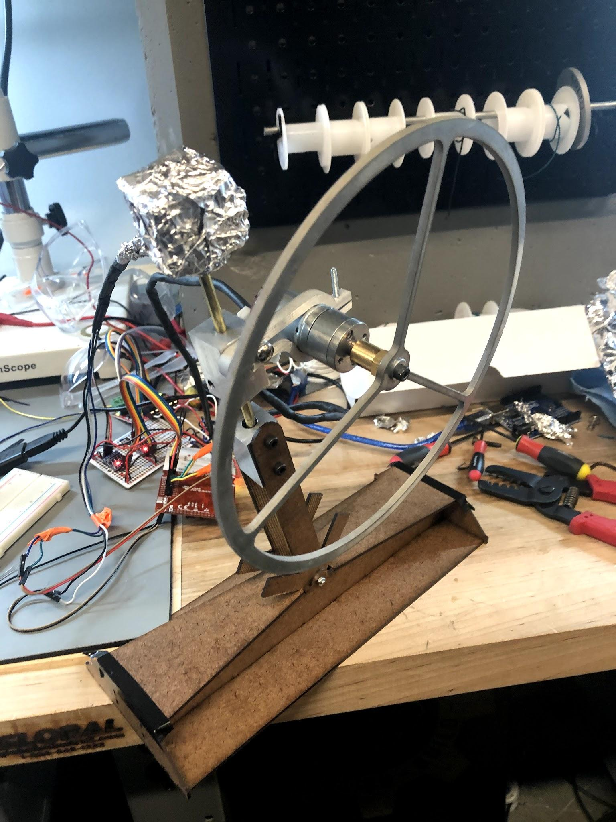
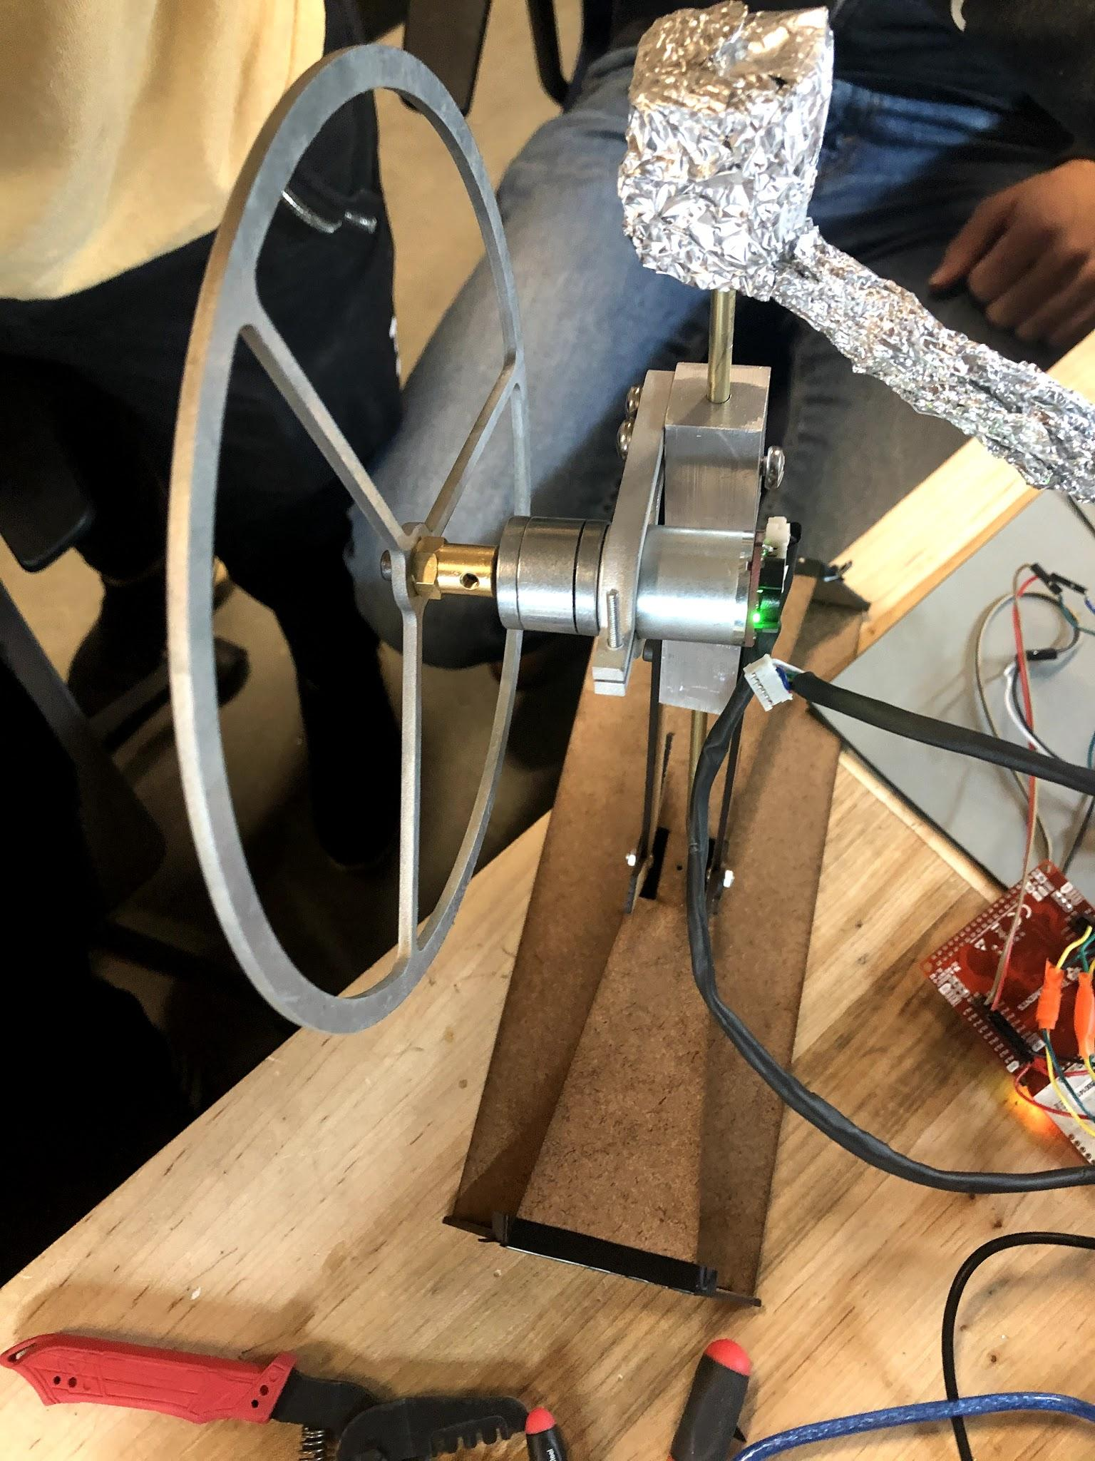
The Final Build

Slide 10
Non-Linearity Problems Encountered
Motor-deadzone
Motor doesn’t move when angle is too small (calculated duty cycle is too small)
Rate-Limit
Motor cannot physically accelerate as fast as we would like it to
After implementing rate-limiter, motor is required to exceed saturation limit
Saturation Limit
Motor is barely powerful enough
Exceeds saturation limit after rate-limiter is implemented

Slide 11

Problems
The non-linearity problems
IMU data is corrupted by the magnetic field generated by motor
Attempted to use aluminium foil to shield IMU (makeshift faraday’s cage)
Ground noise
Flywheel initially not large enough (Moment of Inertia too small)
Bigger and heavier flywheel installed (10x the moment of inertia)

Slide 12
Conclusion
Use shielded wire for wiring IMU to attempted to eliminate EMI
Select a motor with smaller dead-zone
Find a way to deal with motor dead-zone effectively

